Slide 1
Discussion Session Week 3
Conditionals, Loops, Tips and Tricks

Slide 2
Before we get started
Your first homework will likely be released soon, here are some tips
Start early
You will typically be given a week for each assignment, use it
Late work is not accepted in this class
Read the assignment a few times before starting
“Weeks of coding can save you an hour of planning”
Seriously, don’t just try to code without understanding what the assignment does
Utilize your resources
Come to office hours, read the slides, look online

Slide 3
Context
Conditionals and loops are what makes up a bulk of programming
A clever use of them can solve just about any problem you encounter
Mastering these skills is essential for you to become successful as a programmer
Assignments will require them

Slide 4
The basics

Slide 5


Different formatting
Sometimes we can chain statements to get them formatted the way we want them to be
There are a few ways to achieve the same outcome (as with most programming principles)

Slide 6
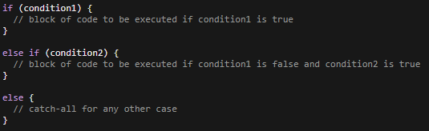
If / else
Works the same as it does in Python
The only real difference is that instead of ‘elif’ we use ‘else if’
Conditions always need to be in parentheses and followed by a set of braces

Slide 7
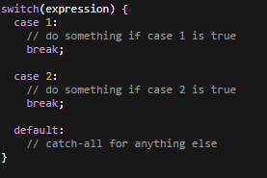
Switch statements
Think of these as a really condensed set of if/else statements
Like a set of if/else statements, switch statements only evaluate once
Optional, but important (use them for now)
break will get you out of the statement when it’s done. If there is no break statement, it will also run all of the cases below the triggered case.
default acts the same as your catch-all ‘else’ statement
We can only use chars or ints as our expression
This has to do with internal representation of the expression as well as the cases needing a constant value
I encourage you to look into this!

Slide 8
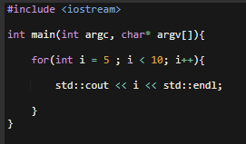

For loops
We’ve already gone over for loops, but here’s another example

Slide 9
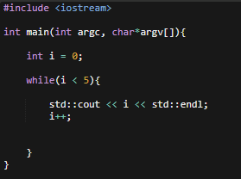

While loops
Again, it’s very similar to how it works in Python
Variable declaration, followed by the loop with a boolean expression that evaluates to true. This process continues until the condition is false.

Slide 10
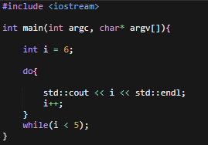
do/while loops
This is a variation of a while loop in which the body of the loop will be executed at least once
Rather than executing the body of the loop only if the condition is true, the body is executed prior to the condition being checked
If the condition is true, the body will execute again like a normal while loop

Slide 11
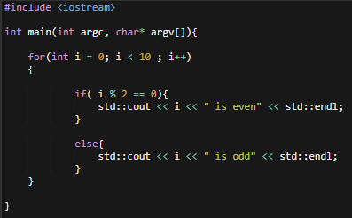
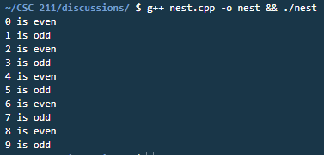
Nesting
We can nest pretty much any conditional or loop inside of another conditional or loop
Try not to nest too many loops at once, it’ll slow down your program quite a bit
A short example

Slide 12
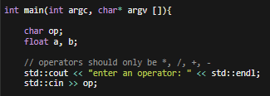
Exercise 1
Complete the following tasks for a simple calculator
create two functions that handle the logic in different ways
One that handles the calculator logic using if/else statements
One function that handles the same logic with a switch statement
Print the equation and the result
This should be in the form <num1> <op> <num2> = <output>
Note: You only need to handle the four basic operators ( *, /, +, - ) but you can do others if you finish early
Keep in mind that modulo (%) is different from division (/)

Slide 13
Beyond the basics

Slide 14
Useful Things to Remember
In C/C++, everything can be evaluated to either true or false
Examples:
if(1)
if(myCharStr)
if (!varName)
while(str[i])
etc

Slide 15
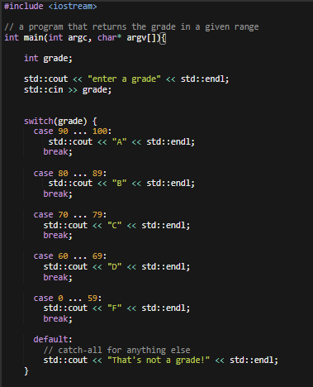

Ranged Switch Statements
Recall the range keyword from Python and how we used it
C++ range statements have a similar functionality that allows us to evaluate an expression between a minimum and maximum value
We identify these ranged by three periods with a space on either side ( … )
We can find ranges between both ints and chars
1 … 99
‘A’ … ‘Z’

Slide 16


Conditional formatting
Don’t see any brackets around a conditional or loop? Assume the next line is iterated over/ run on the logic above it
We call these kinds of statements one-liners
Or

Slide 17
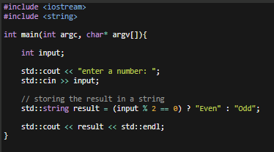


More formatting
Recall the following snippet from the std::min we looked at last week
This is called a ternary operator
result = (condition) ? true_branch : false_branch

Slide 18
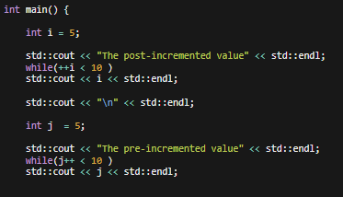
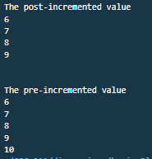
Pre-increment and post-increment operators
Pre-increment
Before assigning a value to the variable, the value is incremented by one
++i
Post-increment
After assigning a value to the variable, the value is incremented by one
i++

Slide 19
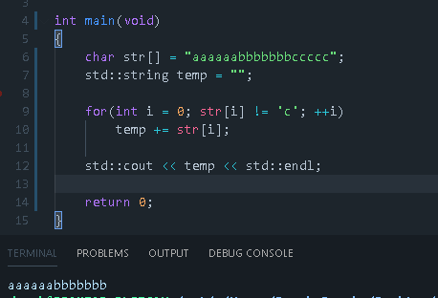
More on Using For Loops
The 3 sections can be anything you want
They are always executed in the same order
++i could be replaced with i+=2, or some other expression too

Slide 20
Exercise 2
Using a pair of nested loops, do the following
Print out the following statement
X + Y = Z
Where x is all even numbers up to and including 10
Y are powers of 3 starting at 1 and including 81
Z is the sum of X and Y

Slide 21
Arrays

Slide 22
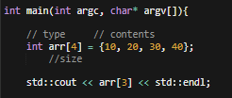
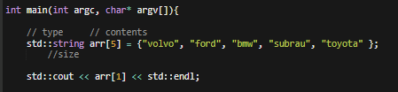
The basic setup
Arrays are analogous to lists in Python
Same general idea, store a bunch of things in one continuous structure
The difference lies in how we’re able to utilize them
Only things of the same type can be in a C++ array
We need to tell the compiler how much space we need as we initialize the array

Slide 23
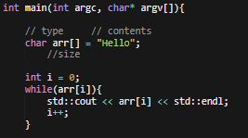

Iterating through an array
Keep in mind that we can treat strings similarly to how we do in Python - as an array of characters
Note that when setting equal to a string, we don’t need to explicitly state the array size

Slide 24
One last thing

Slide 25
Survey
Here is a google survey that I made to rate discussion sessions
Please fill this out so I can better understand how you’d like these discussions to be conducted
If you do not fill it out I won’t know what to change
There are some things I will need to go over/ go through quickly, but I can do my best to accomidate

